Slide 1
Structured Query Suggestion for Specialization and Parallel Movement: Effect on Search Behaviors
Date: 2012/10/18
Author: Makoto P. Kato , Tetsuya Sakai , Katsumi Tanaka
Source: World Wide Web conference (WWW "12)
Advisor: Jia-ling, Koh
Speaker: Jiun Jia, Chiou

Slide 2
Outline
Introduction
Problem Definition
SParQS Backend Algorithm
Clustering entity
Clustering queries
Clssifying query suggestion
Experiment
Conclusion

Slide 3
Introduction
Traditional query suggestion
Camera
Relevance
High
Low
Nikon camera
Canon camera
….
….
….
….
Query suggestion list

Slide 4
Introduction
Popular query reformulation:
Specialization
Nikon Nikon camera
a broad or ambiguous query is modified to narrow down the search result
Parallel
movement
Nikon camera Canon camera
the user’s topic of interest shifts to another with similar aspects

Slide 5
Current query
the user wants to select a query suggestion strictly related to "Nikon"
Nikon
Specialization
Cluster
Query suggestion
Nikon camera,
Canon ixy
Canon ixy
Nikon camera
Nikon camera
Parallel
movement
Helpful
Canon camera
Query
suggestion
Canon ixy
It’s difficult for simple clustering approaches to support specialization and parallel movement simultaneously.

Slide 6
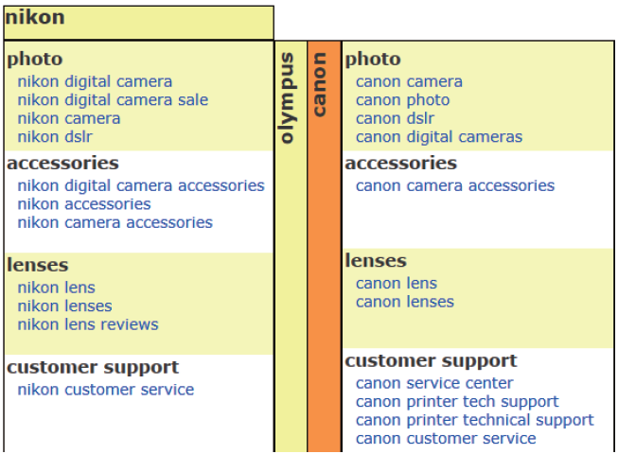
Specialization and Parellel movement Query Suggestion
[SParQS]
Diagonal
movement
Notes:
the current query is “nikon,” and
some specialization suggestions for “nikon” are classified into several categories such as photo and accessories.
2. parallel movement, alternative entities “canon” and “olympus”are presented vertically Ex:“canon” is selected as the current alternative entity.

Slide 7
Introduction
log of queries and clicked URLs from Microsoft’s Bing
SParQS back-end algorithm:
clustering entities
clustering queries
Classifies query suggestions
1 2 3
Notes:
1. clusters entities(e.g. “nikon,” “canon” and “olympus” in Figure 1) based on queries that contain these entities.
2. clusters queries based on clicked URLs, and selects some clusters as query suggestion categories(e.g. photo and accessories)
3. Classifies query suggestions into labeled categories that are shared across entities.

Slide 8
Outline
Introduction
Problem Definition
SParQS Backend Algorithm
Clustering entity
Clustering queries
Clssifying query suggestion
Experiment
Conclusion

Slide 9
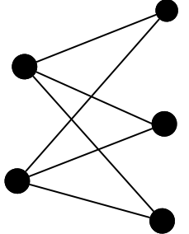
Problem Definition
Q | set of queries
U | set of URLs
w(q,u) | how many times a URL u ∈ U presented in response to a query q ∈ Q has been clicked
E | set of entities , Ex: Wikipedia entry titles
S_{j} | set of query suggestions for each entity e_{j} ∈ E
n | the number of query suggestion categories required
Clickthrough data
2
URL 1
3
Query 1
1
2
URL 2
5
4
Query 2
URL 3

Slide 10
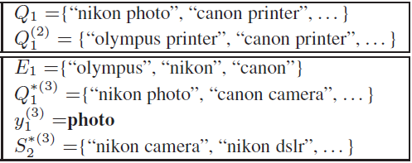
ε={E_{1,} E_{2,} E_{3,……..}} | set of entity clusters
 | set of query suggestion categories for each entity cluster E_{i}
Y_{i} | set of labels for each entity cluster E_{i}
 | a class of query suggestion sets
Query: nikon
SParQS
Query
Suggestion
nikon camera , nikon lens
classify
Label

Slide 11
Three Criteria:
Evenness of Categories:
Ex: the entity cluster {“nikon”, “canon”, “olympus”}
category label : "ixy"
Specificity of Categories:
Ex: the entity cluster {“nikon”, “canon”, “olympus”}
category: "Product"→ too broad
Accuracy of Suggestion Classification:
Ex: "canon printer" classified into photo.
Not suitable
Confuse the user
Notes:
Categories should be chosen so that they are equally useful to all the entities in the cluster.
Categories should be chosen so that they are neither too broad nor too narrow.
3. Given a set of categories, query suggestions should be classified appropriately.

Slide 12
Outline
Introduction
Problem Definition
SParQS Backend Algorithm
Clustering entity
Clustering queries
Clssifying query suggestion
Experiment
Conclusion

Slide 13
SParQS Backend Algorithm
From a query log, query contexts are obtained for each entity by replacing the occurrences of the entity in queries with a wildcard.
entity queries
query contexts: "∗ camera" " price ∗ camera “
c= "prefix e suffix" e= "canon " donate: c(e)
canon
canon camera
price canon camera
C= {c|c(e) ∈ Q ^ e ∈ E }
Entity total: 250,000
Define : entity vector V_{e} (e:canon)
<canon camera , canon photo , canon lens , …..>
Top 10

Slide 14
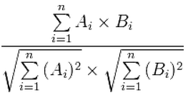
Clustering Entities:
w(c_{l}(e), u):the number of times a URL u
has been clicked in response to the
query q.
V_{canon} :
<canon camera , canon photo , canon lens , …..>
# of click
URL 1 : 3
URL 2 : 2
URL 3 : 1
URL 4 : 2
URL 5 : 2
<10 , 4 , 5 , …..>
V_{olympus} :
<5 , 3 , 9 , …..>
Cosine similarity:${\text{ [}\text{10∗5+4∗3+5∗9+…}\text{]}}/{\text{[} \text{(10}\text{2}\text{+4}\text{2}\text{+5}\text{2}\text{+….)}\text{1/2} \text{∗(5}\text{2}\text{+3}\text{2}\text{+9}\text{2}\text{+….)}\text{1/2}\text{]}}$
Group-average hierarchical cluster
Obtain a set of entity cluster ε={E₁ , E₂ , ….}

Slide 15
 | Entity 1 | Entity 2 | Entity 3
Entity 1 | 0 | 0.29 | 0.24
Entity 2 | 0.29 | 0 | 0.37
Entity 3 | 0.24 | 0.37 | 0
Group-average hierarchical cluster
 | Entity 1 | Entity 2,3
Entity 1 | 0 | <1>
Entity 2,3 | <1> | 0
<1> : (0.24+0.29)/2=0.265
 | Entity 1 | Entity 2,4 | Entity 3
Entity 1 | 0 | 0.24 | 0.37
Entity 2,4 | 0.24 | 0 | 0.45
Entity 3 | 0.37 | 0.45 | 0
 | Entity 1 | Entity 2,3,4
Entity 1 | 0 | <2>
Entity 2,3,4 | <2> | 0
<2> : (0.24*2+0.37)/3=0.283

Slide 16
Outline
Introduction
Problem Definition
SParQS Backend Algorithm
Clustering entity
Clustering queries
Clssifying query suggestion
Experiment
Conclusion

Slide 17
Clustering Queries:
w(c(e_{j}),u) : the sum of click counts of
queries that have the same context c.
Define : query vector V_{q} (q=c(e))
c= "prefix e suffix" e₁= "canon "
e₂= " nikon "
e₃= "olympus "
* camera
URL 1
URL 2
URL 3
URL 4
URL 5
…
Top 10
V_{* camera} :
<URL 1, URL 2, URL 3 , …..>
<5+2+3 , 4, 5, …..>
V_{* photo} :
<5 , 3 , 9 , …..>
Canon camera
# of URL 1 clicked :
5
Cosine similarity:
Nikon camera
# of URL 1 clicked :
2
Group-average hierarchical cluster
Olympus camera
# of URL 1 clicked :
3
Obtain a set of query cluster

Slide 18
Outline
Introduction
Problem Definition
SParQS Backend Algorithm
Clustering entity
Clustering queries
Clssifying query suggestion
Experiment
Conclusion

Slide 19
Classifying Query Suggestion:
Define : query cluster vector V_{Q}^{(k)}
(_{Q}^{(k)} ={Canon camera, Nikon camera , Olympus camera,….})
Define : query suggestion vector V_{s}
Accuracy
If Sim(_{Q}^{(k)}, s)> θ
classify a query suggestion s into a query cluster _{Q}^{(k)}
Choose n query clusters as categories to classify query suggestion
Evenness
Query suggestion entropy over entities
Specificity
Query suggestion entropy over categories

Slide 20
Query suggestion entropy over entities
Nikon
Olympus
Canon
Photo
Photo
Photo
Nikon digital camera
Nikon camera
Nikon dslr
Olympus camera
Olympus digital camera
Canon camera
Canon photo
Canon dslr
Canon digital camera
P_{photo}(Nikon)=$\frac{3+1}{\left(3+2+4\right)+1∗3}$ = 0.33
Hk(E)
Query suggestions classified into a category are distributed more evenly across entities.
P_{photo}(Olympus)=$\frac{2+1}{\left(3+2+4\right)+1∗3}$ = 0.25
P_{photo}(Canon)=$\frac{4+1}{\left(3+2+4\right)+1∗3}$ = 0.416
H_{photo}(E)= -[(0.33*log 0.33)+(0.25*log 0.25)+(0.416*log 0.416)]= 0.4679
Notes:
P_{K}(ej) represents the probability that a query suggestion classified into a category _{Q}^{(k)} is of an entity e_{j}.

Slide 21
Query suggestion entropy over categories
Nikon
Photo
Nikon digital camera
Nikon camera
Nikon dslr
P_{Nikon}(photo)=$\frac{3+1}{\left(3+3+3\right)+1∗3}$ = 0.33
P_{Nikon}(accessories)=$\frac{3+1}{\left(3+3+3\right)+1∗3}$ = 0.33
accessories
P_{Nikon}(lenses)=$\frac{3+1}{\left(3+3+3\right)+1∗3}$ = 0.33
Nikon digital camera accessories
Nikon accessories
Nikon camera accessories
H_{Nikon}( )=
-[(0.33*log 0.33)+(0.33*log 0.33)+(0.33*log 0.33)]
= 0. 4767
lenses
Nikon lens
Nikon lenses
Nikon lens reviews
query suggestions of an entity e_{j} are distributed more evenly across categories

Slide 22
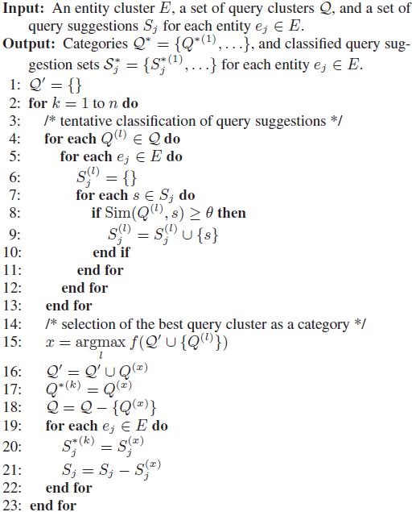
n=5
Classification
of query
suggestion
θ=0.3
Select best
query cluster
as categories

Slide 23
Q^{(l)}: {nikon photo , nikon camera , nikon digital camera} e_{j} : nikon
S_{j} :{nikon lenses, nikon accessories, nikon customer service,…….}
Q⁽¹⁾
Q⁽²⁾
Q⁽³⁾
……….
Max
Query
cluster
set
nikon photo,
nikon camera,
nikon digital camera
Clustering query
nikon photo=< 6,3,2,…>
nikon camera=< 3,1,5,…>
nikon digital camera=< 2,4,2,…>
query cluster vector
< 11,8,9,…>
Cosine similarity
>θ:0.3
query suggestion vector:
<#of top 1 url that clicked,top 2 url,…>=<3,5,4,…>
s1=<3,5,4,…>
s2=<6,1,2,…>
s3=<3,1,1,…>
s4=<4,3,2,…>
…..
Has been Classified
s1=<3,5,4,…>
s2=<6,1,2,…>

Slide 24
Outline
Introduction
Problem Definition
SParQS Backend Algorithm
Clustering entity
Clustering queries
Clssifying query suggestion
Experiment
Conclusion

Slide 25
Experiment
Data-Microsoft Bing’s query log from April 25th to May 1st , 2010
Input: 〈named entity list〉
Total : 5,156
Manually chose 20 entity clusters that had at least 2 entities from each of the 5 entity classes.
Record | 3,503,469,327
Unique queries | 76,462,963
Unique URLs | 62,978,872
company
2,000
person
119
landmark
1,203
city
388
Query clustering
Entity clustering
product
1,446
nikon , canon ,
olympus
Entity class:
company
sharp , samsung ,
lg ,sony ,panasonic
Notes:
P.S To generate query suggestions, we applied the hitting time algorithm
First, constructed a clickthrough bipartite graph, where queries and URLs are nodes and each edge represents a URL click in a search engine result page produced in response to a query. The click count w(q, u) is used as the weight of each edge. For every query pair, we computed the hitting time of a random walk, defined as the expected number of
steps it takes from a query to another on the bipartite graph. Finally, we selected 20 queries that are the “closest” to each query.

Slide 26
Two assessors evaluated categories of 100 entity clusters with five types of values for a parameter λ.﹝2459 categories﹞
Showed a list of category labels, a set of entities, and their unclassified query suggestions.
Precision : $\frac{\text{the} \text{number} \text{of} \text{highly} \text{or} \text{somewhat} \text{relevant} \text{categories}}{\text{the} \text{total} \text{number} \text{of} \text{evaluated} \text{categories}}$
Irrelevant
Somewhat relevant
Highly relevant
specificity
evenness
Precision

Slide 27
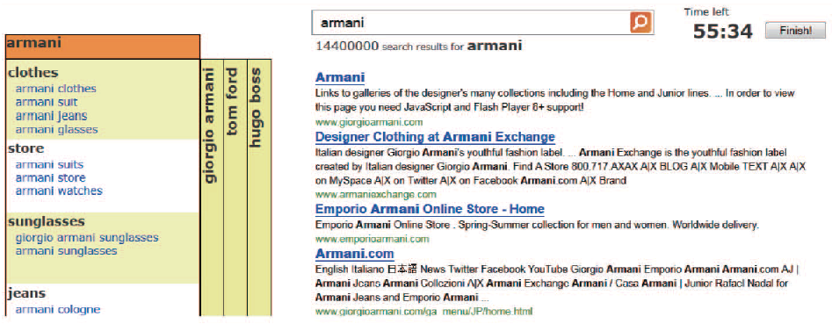
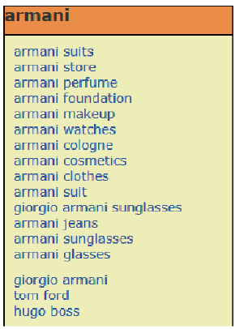
Prepared 20 tasks , hired 20 subjects and asked users to collect answers relevant to each task within five minutes. For each task, each subject used either the SParQS interface, or a flat list interface as a baseline to complete the task.
10 Information Gathering tasks
finding information about the given entity
query " nikon " → " nikon cameras "
10 Entity Comparison tasks
finding information about entities related to the given one in terms
of a particular aspect Ex:"competitors such as Canon and Olympus"
Specialization
Parallel MOVEMENT

Slide 28
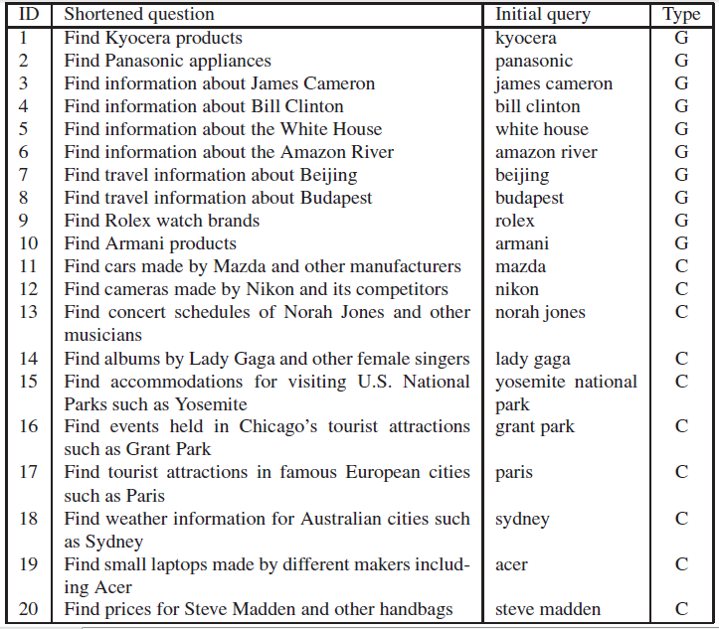
G:Information Gathering task
C:Entity Comparison task
Notes:
1.Our 20 subjects were undergraduate or graduate students in computer science in their twenties.
2.The subjects were asked to collect as many answers relevant to each task as possible within five minutes.
3.the subjects filled out a questionnaire about that particular task. Upon completion of the 20 tasks, the subjects filled out a questionnaire about the entire experiment
and their preference of interfaces.

Slide 29
User study
Questionnaire
Scores: 1 (Not at all), 2, 3 (Somewhat), 4, and 5 (Extremely)
Notes:
§ 1 :the SParQS users found more answers in Entity Comparison tasks and fewer answers in Information Gathering tasks [Table 4(a)]. But these are not statistically significant.
§ 2 :Especially in Entity Comparison tasks, the SParQS users found answers for significantly more entities than the flat list users[Table 4(e)].
§ 3 :the SParQS interface was helpful in Entity Comparison tasks in terms of finding answers, but underperformed the flat list interface in Information Gathering tasks.

Slide 30
Outline
Introduction
Problem Definition
SParQS Backend Algorithm
Clustering entity
Clustering queries
Clssifying query suggestion
Experiment
Conclusion

Slide 31
Conclusion
This paper proposed a new method to present query suggestions to the user, which has been designed to help two query reformulation actions: specialization and parallel movement.
SParQS classifies query suggestions into automatically generated categories and generates a label for each category.
SParQS presents some new entities as alternatives to the original query, together with their query suggestions classified in the same way as the original query’s suggestions.
Results show that subjects using the flat list query suggestion interface and those using the SParQS interface behaved significantly differently even though the set of query suggestions presented was exactly the same.

Slide 32
Thank you for
your attention !

